Slide 1
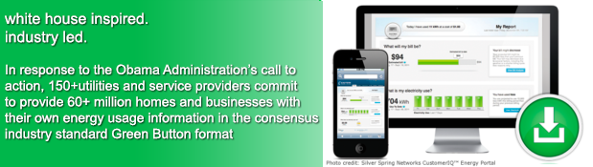



Multiple List Service and
The Green Button Initiative
Greg Manship, CEO Intermountain MLS, gmanship@intermountainmls.com
John Teeter, Computer Scientist, NIST, john.teeter@nist.gov
Presidential Innovation Fellow Alumni

Slide 2
Thoughts and Questions??
Vision and Value?
What Opportunities exist?
Partners -- BSU? Idaho Power? … ?
What is the volume of new listings?
Experiments and Pilots??

Slide 3

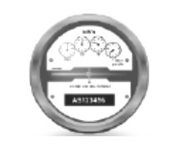


Listing a House – 13 Months of History
MLS Data Repository
Analytics
Virtual Energy Audits
Community Comparisons
…
Utility
Meter Data
Portal
Agency/Owner
Management
Benchmarking
Sales Promotion
…
Utility
Meter
Home
Energy Management System (EMS)
Refrigerator
HVAC
…
Realtor
Client Approval
Notes:
Brian overlay – clean up arrows

Slide 4


Showing the Property
MLS Data Repository
Analytics
Virtual Energy Audits
…
Utility
MDM
Portal
Agency/Owner
Management
Benchmarking
…
Utility
Meter
Home
Energy Management System (EMS)
Refrigerator
HVAC
…
Notes:
Brian overlay – clean up arrows

Slide 5




Federal Government Interest in Data
Open Data Initiatives
Making government information resources more publicly accessible in “computer-readable” form; encouraging its use by entrepreneurs fueling the creation of new products, services, and jobs
Project Open Data: http://project-open-data.github.io
http://www.data.gov is primary entry point
My Data Initiatives
Empowering consumers with secure access to their own personal energy, health, and education data
Green Button (energy), Blue Button (health info), Education, …

Slide 6
What is Green Button? – How is it useful to the economy?
The Green Button Initiative encourages all utilities and service providers to standardize the format and communication of energy data so customers and third-party service providers can easily access and exchange energy usage information from utility or electricity suppliers.
The cost of resources is a significant portion of our national spend. 40%

Slide 7
Green Button Evolution
White House Call to Action
Connect My Data Beta Deployments
American Energy Data Challenge
Green Button
CMD Certifications
9/2011
NAESB ESPI Standard Ratified
12/2012
11/2013
4Q 2014
HEY Update w/Green Button
Presidential Memorandum to Federal Agencies
10/2011
First DMD
Available
1/2012
DMD Certifications
Green Button CMD Rollouts
Nationally
DOE Apps for Energy
4/2013
12/2013
2H/2014
5/2012
1H/2015
2011
2012
2014
2013
2015
0 Customers
(Download My Data)
12 Million Customer Accounts*
26 Million Customer
Accounts*
42 Million Customer
Accounts*
* Represents Customer Accounts with Access to Green Button Data – Primarily DMD; Actual Customer download numbers are not available
Notes:
1 – DoE Energy-Apps
a) SDG&E and PG&E released their Green Button support within 90 days of the Call to Action
b) DoE sponsored an Apps for Energy challenge to stimulate ecosystem growth
2 – EPA PM Upgrade: EPA release of API moved Portfolio manager to an Open API platform and set the stage for future Green Button support,
the details of which will be reflected in the EPA portion of the agenda (not wanting to steal their thunder.

Slide 8


Download My Data and Connect My Data
A customer visits their utility web portal, they can simply login and download their Green Button Data as an XML-formatted file.
This powerful model allows a consumer to authorize a third-party service provider to receive direct access to their Green Button Data - no need to repeatedly login to their utility and download files. These authorizations are valid for an agreed upon time and can be revoked at anytime by the consumer.

Slide 9



















Green Button Supports Innovation in New Applications
Insight: entrepreneur-created web portals analyze energy usage and provide actionable tips;
Heating and Cooling: customized heating and cooling activities for savings and comfort;
Education: community and student energy efficiency competitions;
Retrofits: improved decision-support tools to facilitate energy efficiency retrofits, Virtual Energy Audits;
Verification: measurement of energy efficiency investments;
Real Estate: provide energy costs for tenants and/or new home purchasers; and
Solar: optimize the size and cost-effectiveness of rooftop solar panels.
www.greenbuttondata.org
Notes:
9

Slide 10
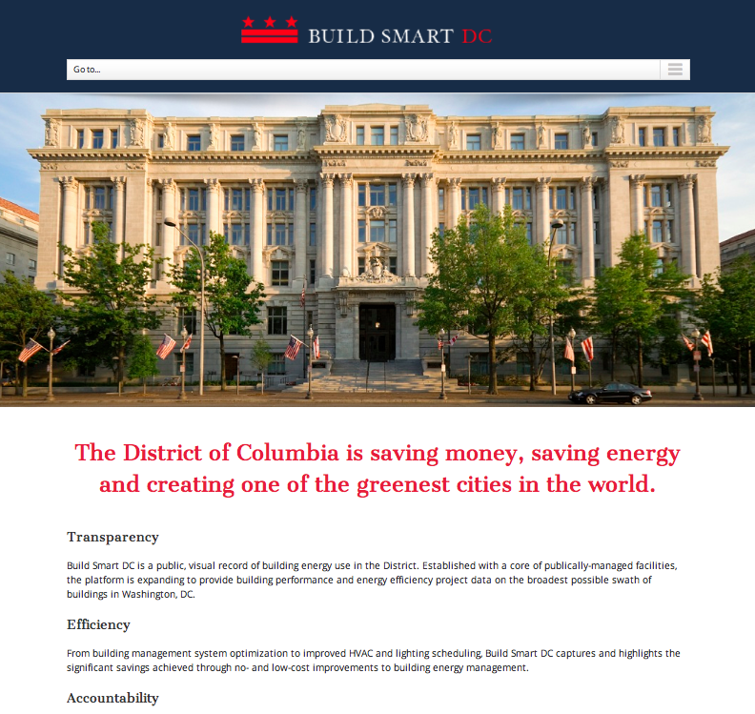
Green Button Connect My Data In Washington DC Governmental Services
Providing 15 Minute
Interval Data for 400
Buildings in DC
Local Utility (Pepco Holdings) providing first in the nation deployment with Green Button Connect My Data inside!
http://www.buildsmartdc.com

Slide 11
Climate Action Plan Commitment
“The Administration will leverage the ‘Green Button’ standard – which aggregates energy data in a secure, easy to use format – within federal facilities to increase their ability to manage energy consumption, reduce greenhouse gas emissions, and meet sustainability goals.”
The President’s Climate Action Plan,
June 25, 2013

Slide 12
US Federal Government Commitment
Presidential Memorandum (to all Federal agencies)
“Sec. 3. Building Performance and Energy Management .. each agency shall: … incorporate Green Button into reporting, data analytics and automation, and processes, in consultation with local utilities …” [.. GSA, EPA pilots …]
Presidential Memorandum on Federal Leadership in Energy Management, Dec 5, 2013
Buildings use 40% of our Energy Resources; 75% of our Electricity
Achieving Efficiency is a National Priority
Green Button provides the missing feedback loop
And helps to engage the consumer in the solution

Slide 13
Federal Leadership in Energy Management
Sec. 3. Building Performance and Energy Management.
A - To encourage continuous improvement and better manage building performance, enhance energy efficiency, and reduce energy waste in an open and transparent way, each agency shall:
install building energy meters and sub-meters
install water meters at agency buildings
… agency buildings …. associated monthly performance data is entered into the EPA Energy Star Portfolio Manager.
publicly disclose … web-based tracking system annual energy performance data
… incorporate Green Button into reporting, data analytics and automation, and processes, in consultation with local utilities
Presidential Memorandum for Heads of Exec.
Departments and Agencies
Dec 2013
.

Slide 14

Thank You

